Slide 1

Finite State Automata in Natural Language Processing
Name : T.Praveen Kumar Reg.No : 192472234
DSA0307 – NATURAL LANGUAGE PROCESSING

Slide 2

Introduction
What is Finite State Automata?
Finite State Automata (FSA) is a mathematical model used to recognize patterns and sequences in text.
It consists of:
Finite number of states
Input symbols
Transition functions
Start state
Accept state
In NLP, FSA helps computers recognize words and language patterns efficiently.

Slide 3
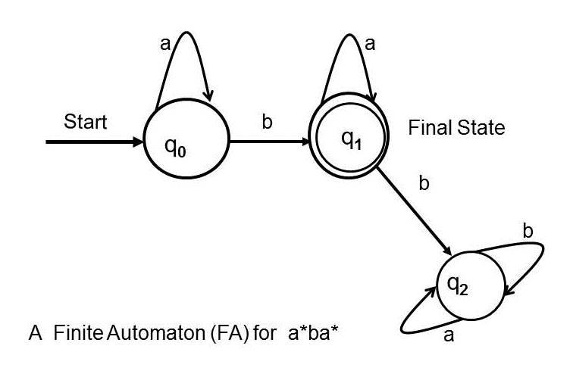
Components
States – Represent different conditions.
Start State – Beginning of processing.
Input Alphabet – Characters or symbols.
Transitions – Move from one state to another.
Accept State – Indicates successful recognition.

Slide 4

Applications in NLP
Fast execution
Simple design
Easy implementation
Low memory requirement
Efficient pattern matching
High processing speed

Slide 5

Limitations
Handles only regular languages
Cannot process nested structures
Limited memory
Cannot understand context
Not suitable for complex sentence parsing

Slide 6

Conclusion
Conclusion
Finite State Automata is a fundamental model in NLP.
It efficiently recognizes text patterns.
It supports lexical analysis, tokenization, and spell checking.
Despite its limitations, FSA remains an essential building block for modern language processing systems.

